Slide 1
SPAM DETECTION

Slide 2
Contents
Problem understanding Model Selection
EDA (Visualization) Interpretation
Preprocessing Model Performance Evaluation
Feature Selection Model implications
Deployment

Slide 3
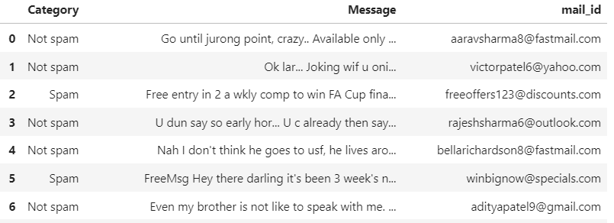
SPAM OR NOT
BINARY CLASSIFICATION
TEXT ANALYSIS
CLASSIFICATION ALGORITHMS
ACCURACY WILL BE KEY
SHAPE (5576,3)
MIGHT REQUIRE MORE
COMPUTATION SPEED

Slide 4
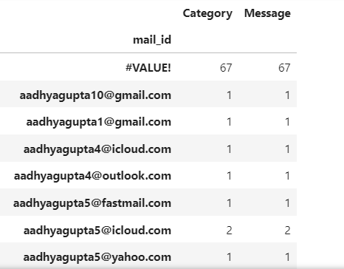
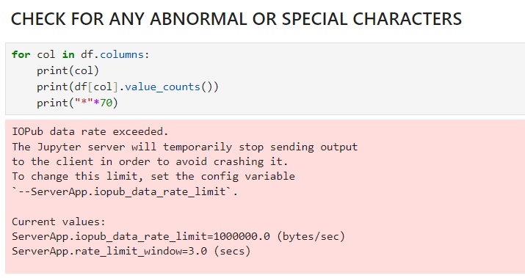
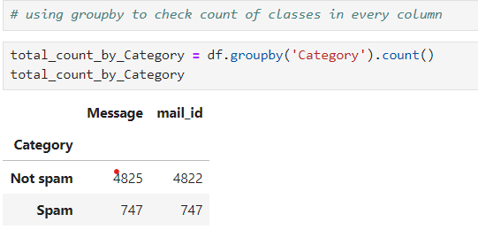

Slide 5
EDA
NULLS
DUPLICATES # not removed
VISUALIZATION ON KEY FEATURE “MESSAGE”
WORD_CLOUD
BAR GRAPH TO CHECK MOST REPEATING TEXT
BAR COMINATION OF TWO WORDS (BIGRAMS)

Slide 6
PREPROCESSING
SEPERATED MAIL ID TO USER_NAME AND DOMAIN
CHECKED MOST SPAMMED DOMAINS AND USERNAME
CHECKED MOST RELIABLE DOMAINS
TEXT CLEANING
TOKENIZATION
LEMMATAZATION
VECTERIZATION
TREATED DATA IMBALANCED

Slide 7
MODELS based on one Feature(“Message”)
Multinomial NB (Naïve Bayes)
Multinomial NB (after smote)
Logistic Regression
RNN

Slide 8
MODELS based on 3 Features
Multinomial NB (Naïve Bayes)
Multinomial NB (after smote)
Logistic Regression
RNN
Random Forest classifier

Slide 9
Model Performance Evaluation
Logistic Regression and Random Forest performed very poor in testing, when 3 featured are considered for training
RNN and NB are performing accurately during both testing and training
RNN performed better than all models both with one and even three features combined
Performed Deployment on NB model with one feature.

